Slide 1

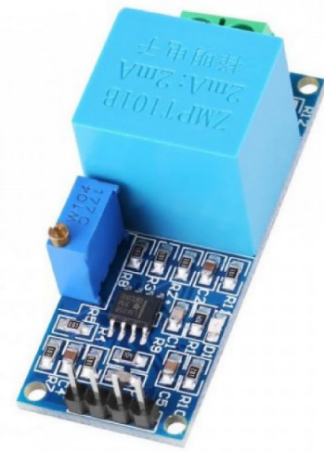
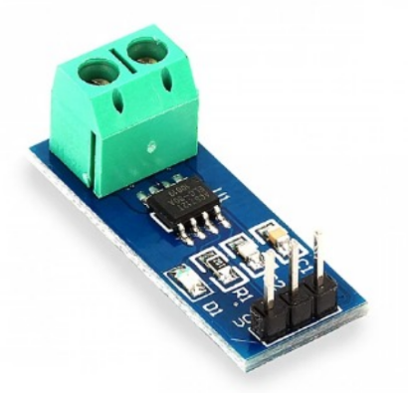
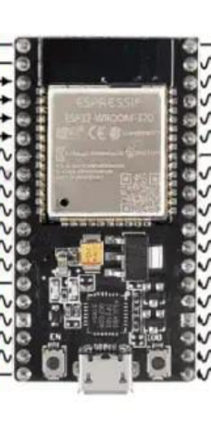
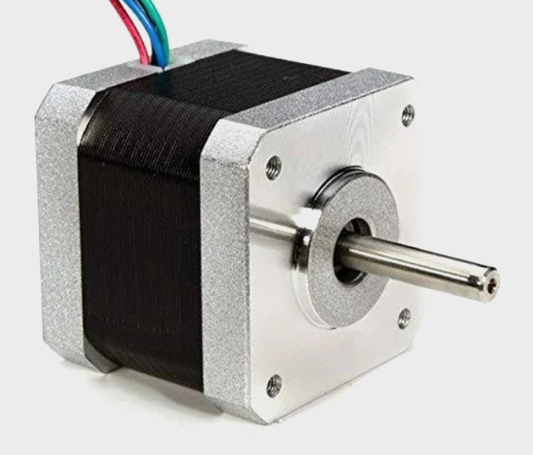
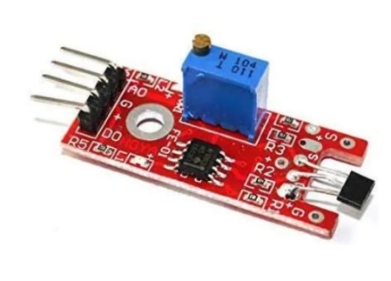
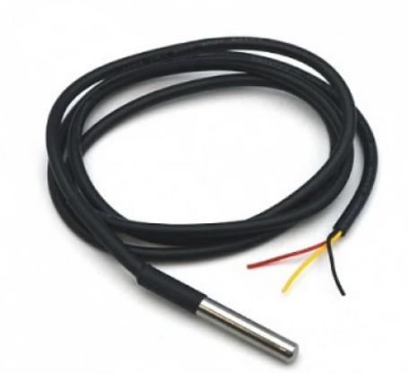
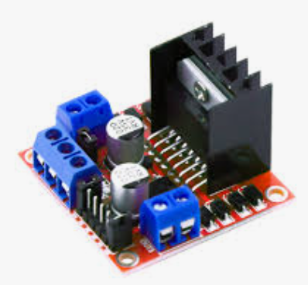
Virtual private cloud (VPC)

Slide 2







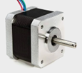





AWS Cloud
Amazon DynamoDB
Send Real-Time Data & Predictions
Store Real-Time Sensor Data
Store Prediction Results
Fast Data Retrieval
Dashboard Query Support
PHYSICAL LAYER
L298N
DASHBOARD
IoT Data Stream
AWS Lambda
Amazon
API Gateway
NEMA 17 Stepper Motor
Real-Time Sensor Monitoring
Failure Prediction Visualization
RUL (Remaining Useful Life)
Anomaly Detection Alerts
Data Trends & Graphs
Set an alert when the sensor data exceeds the threshold value.
AWS IoT Core
Data Parsing
Feature Extraction
Load ML Model (.pkl)
Real-Time Inference
Store Results & Alerts
Processed
• Expose REST APIs
• Connect Dashboard to Backend
• Fetch Predictions & Data
• Secure API Access
AWS IoT Core
Rest API
Predictions
Response
MQTT Broker
Wi Fi
IoT Rule Engine
ESP32
ADXL345
ZMPT101B
Store Historical Data
DS18B20
ACS712
Amazon EC2
Amazon Simple Storage Service (Amazon S3)
Load Model (.pkl)
A3144
• Model Training Environment
• Dataset Preprocessing
• Train ML Models
• Generate Trained Model (.pkl)
• Store Historical Sensor Data
• Store Trained Model (.pkl)
• Data Archival
• Model Access for Lambda
SENSORS
Upload Trained Model (.pkl)

